Slide 1
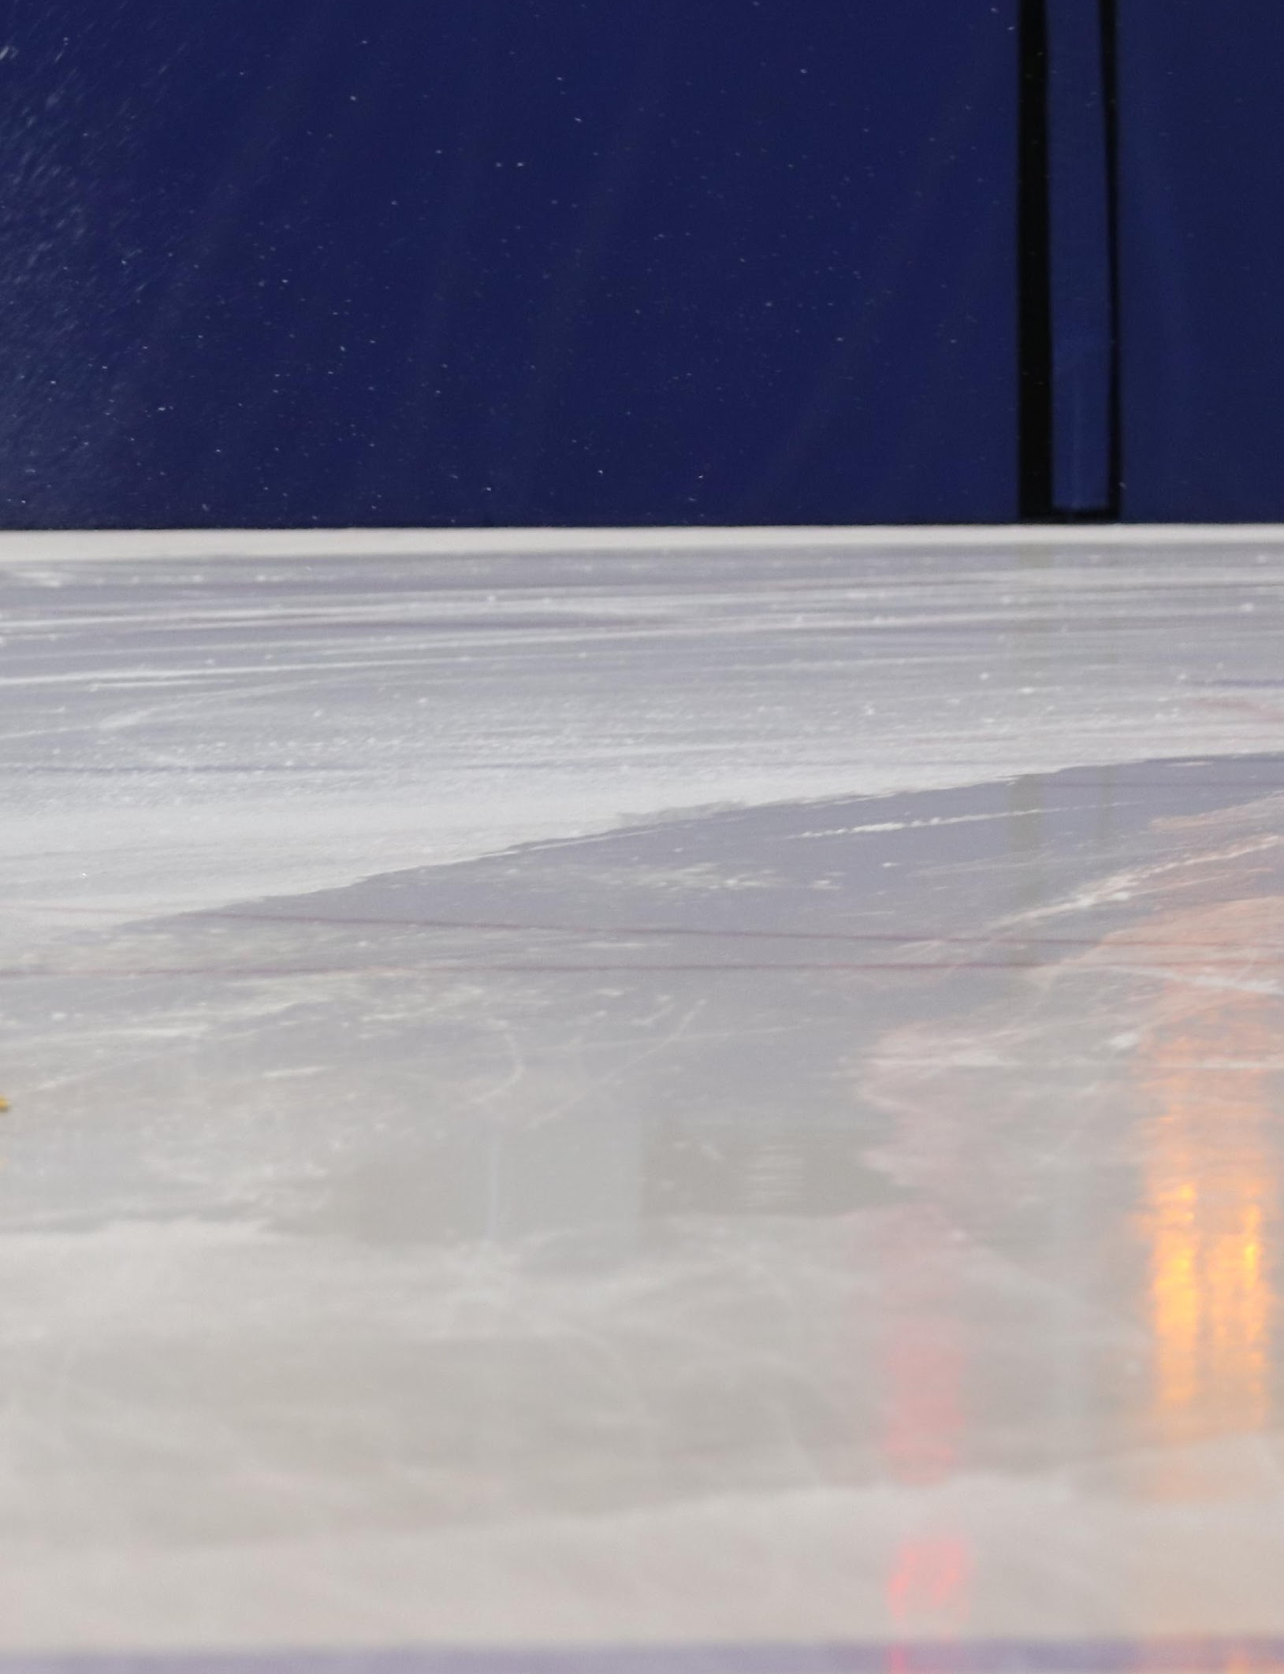
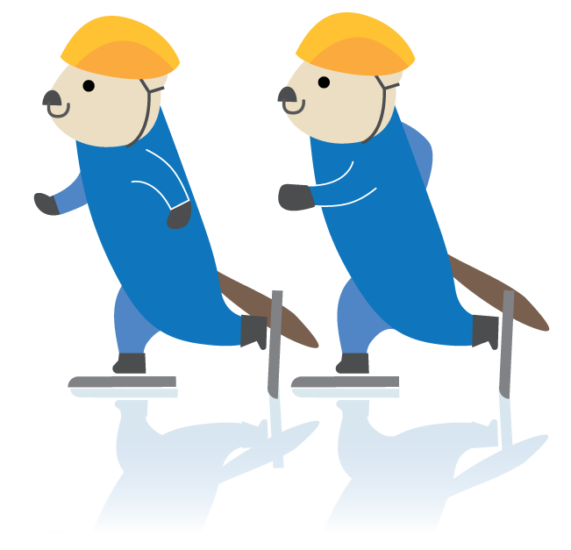
Welcome! [club name and group]
Skating days: [day(s) of the week]
Time: [time program runs]
Program Length: [program start date to end date]
Location: [arena and rink if appropriate]

Slide 2
COACHES
The coaches for your group are:
Lead Coach: [name and contact]
Assistant Coach: [name and contact]
Assistant Coach: [name and contact]
The best way to contact the coaches is [insert club-specific information, e.g. coach emails or electronic communication platform such as WhatsApp group, team management app, etc.].
If you are interested in volunteering as an assistant coach, please contact [insert contact].
OTHER CLUB INFO
[insert other club welcome information here, e.g. how to volunteer for club positions other than assistant coach, COVID-specific protocols, fundraising information etc.]
EQUIPMENT
All participants in speed skating programs must wear protective equipment. The Skate Fast page on the BC Speed Skating website lists required equipment. The equipment helps protect skaters from impact in case of a fall, and also helps protect skaters from cuts due to the sharp blades. [insert any club-specific information, e.g. we have equipment to borrow etc.]
Did you know? Speed skates are sharpened by hand! Proper skate care will keep your skates sharp for longer. Always wear hard guards when walking in speed skates so that the edge of the blade doesn’t become dull. After skating, wipe the skates dry with a towel and store them in soft guards so that the blades don’t rust. [insert club-specific information, e.g. keep your skates for the duration of the session, return them to the equipment room after each practice, etc.]
To learn more about caring for your skates or sharpening your skates, please contact [insert club contact].

